Slide 1
Group 20 Level 4-5
imdcgd111 Group Project
imdcgd214 Managing Games Production
Ross Warren (S176778)
Max Carter (S175573)
Jake Seaman (S183883)
Jack Fuller (S176802)

Slide 2
Brief
MC
Constraints:
2D Environment
Physics based mechanic
Adversarial
Played on a single device
Symmetric
Simple rules

Slide 3
Our Game - Sunny Slide Up
RW
Tagline – Slip and slide delicious eggs into the perfect cooking position. Hard boiled, scrambled and many more egg-stravagant meals come sliding down the pan in Sunny Side Up
Platforms – iOS / Android

Slide 4
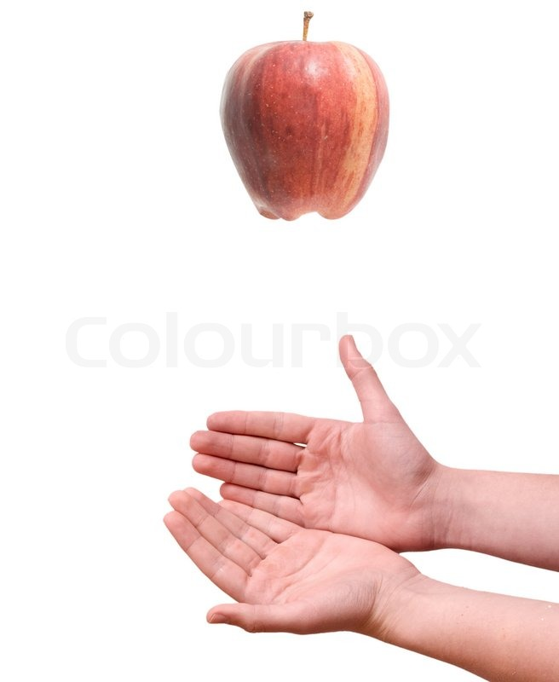
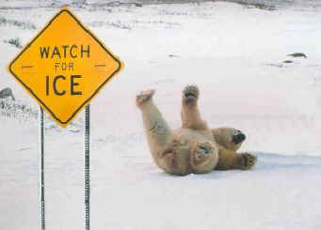


Concepts and Game Ideas
JS
Buoyancy
Friction
Gravity
Light

Slide 5
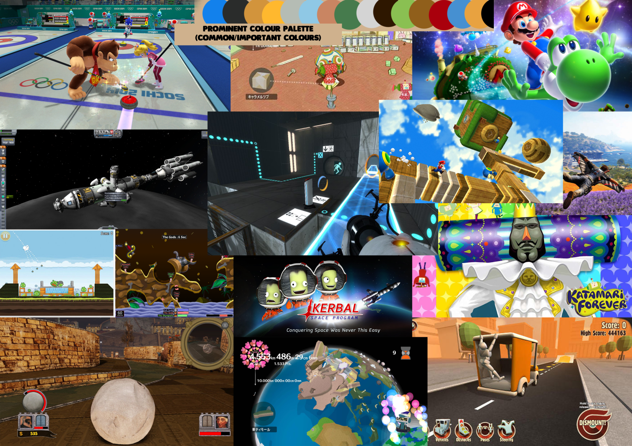
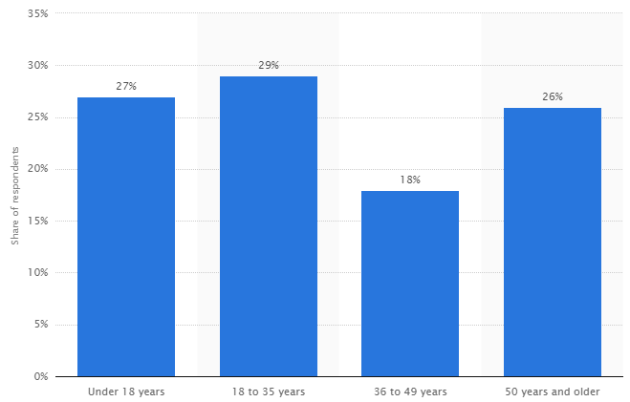
Research + Demographic
JF
Established demographic of mostly males aged 12 – 35
Colourful
Vibrant
Minimalist or smooth
https://www.statista.com/statistics/189582/age-of-us-video-game-players-since-2010/

Slide 6
Old Mechanic
JS
Friction
Twitch

Slide 7
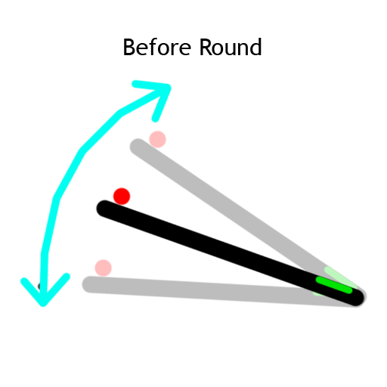
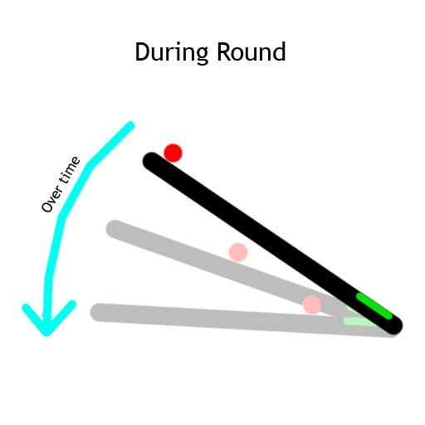
New Mechanic - Angling
MC
Friction
Unpredictability
Twitch mechanic removed
Notes:
We are currently working on playtesting this to see if the players enjoy it and to see if it fits our game

Slide 8
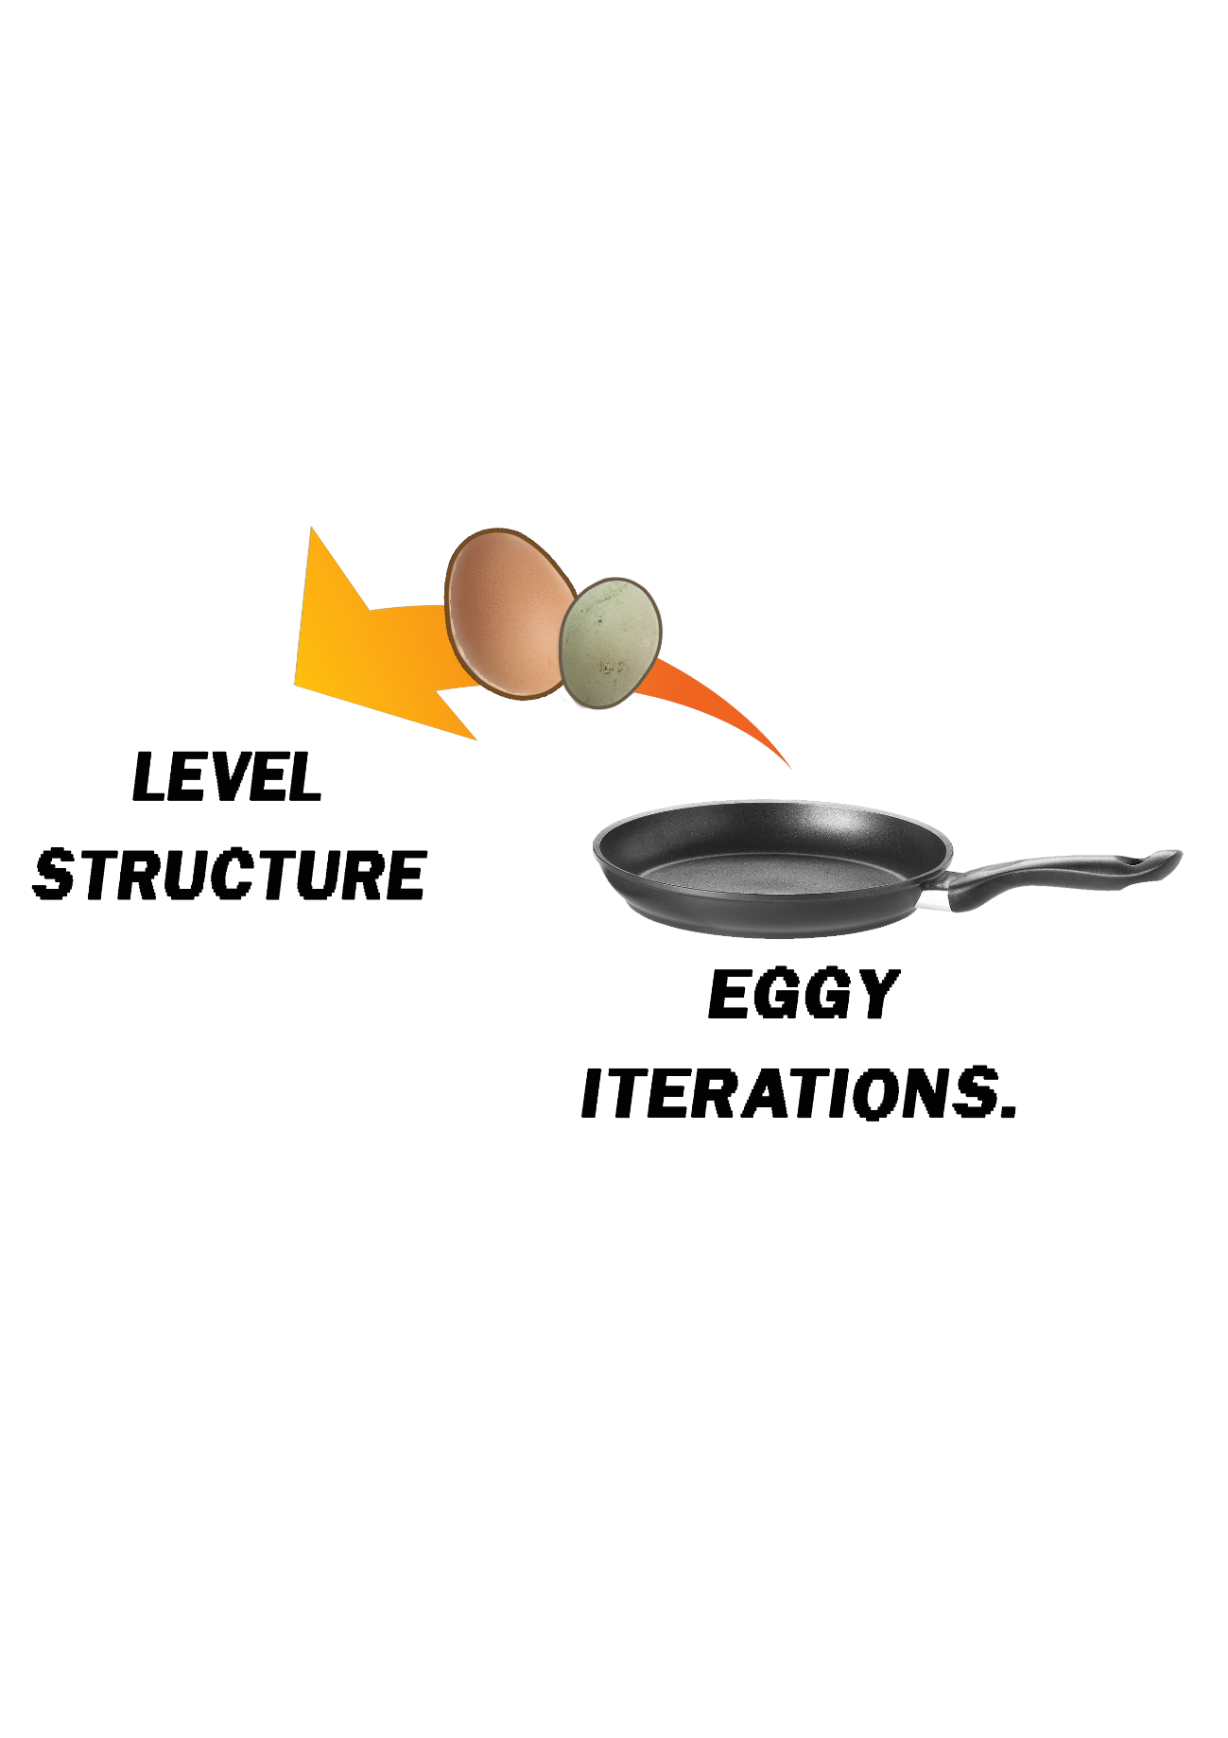
Level Structure
RW
5 Level Structure.
Calls for prefabs of iterations.
Ramps up difficulty.

Slide 9
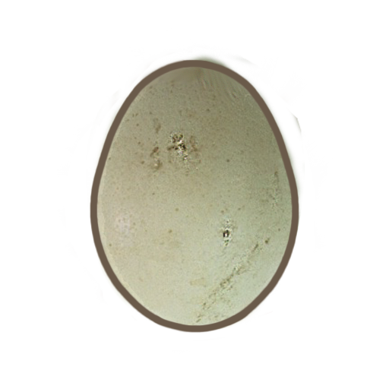
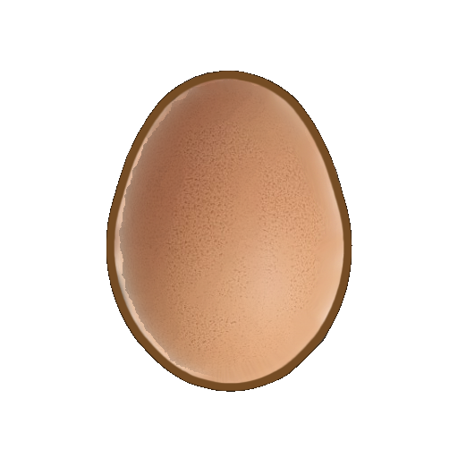
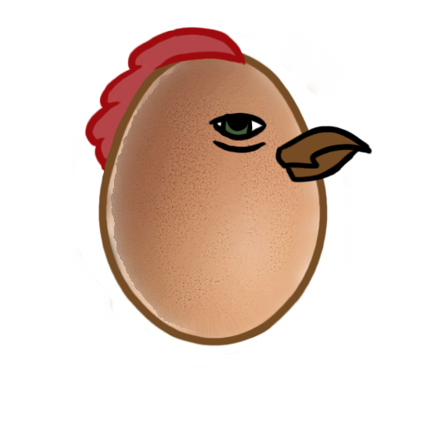

Art assets
RW

Slide 10


Replay Value
JF
Trophies
High Scores
“Omelettin’ this slide”
“Cracking!”
“Shell shock!”

Slide 11
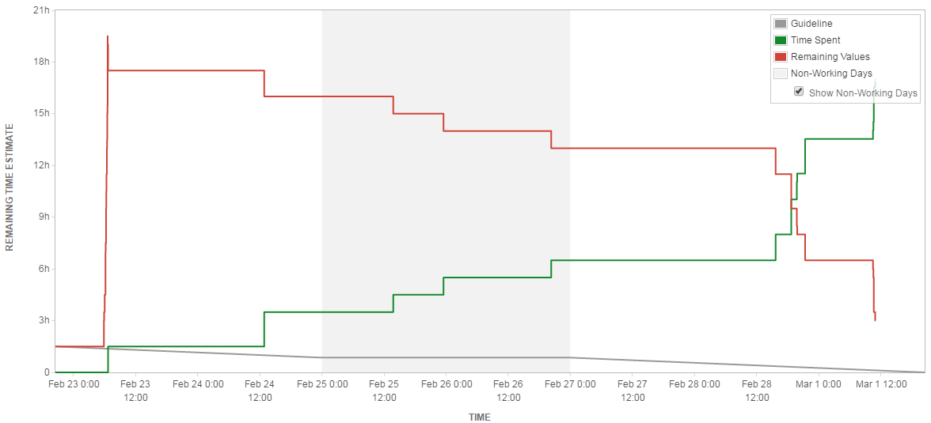
Emails and Jira
MC
Emails this week:
Max – 11 Ross – 8 Jake – 7 Jack - 8

Slide 12
RW
Questions?

